Slide 1
A1 Theory
Archie Thomas

Slide 2
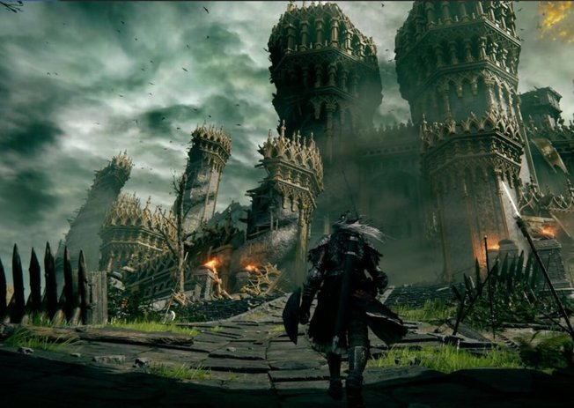
Elden Ring
Graphics – offer a sense of realism and fantasy
The graphics provide an emphasized

Slide 3
Elden Ring
Feel good factor – makes you rage and get very annoyed because the enemies are overpowered but the whole play style is very cozy.

